Slide 1
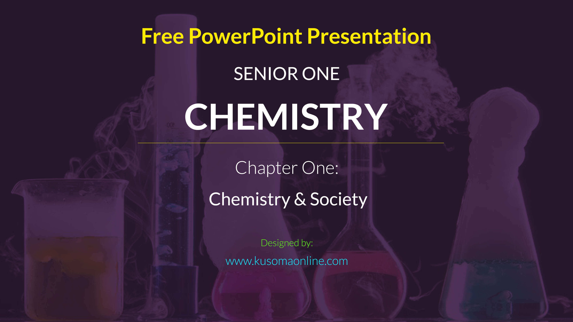

Slide 2

Chemistry and Society
Introduction
explain the discrete nature of chemistry (k, u)
explain why chemistry is studied and how it overlaps with other subjects such as biology, physics, mathematics, and geology (k, u)
explain the importance of chemistry and relate knowledge of chemistry to relevant careers (u)
appreciate the contribution of chemistry to the Ugandan economy (k)
Chemistry, careers, science, technology , society
By the end of this topic, you will be able to assess the application of Chemistry in our everyday life, and its contribution to our economy.

Slide 3
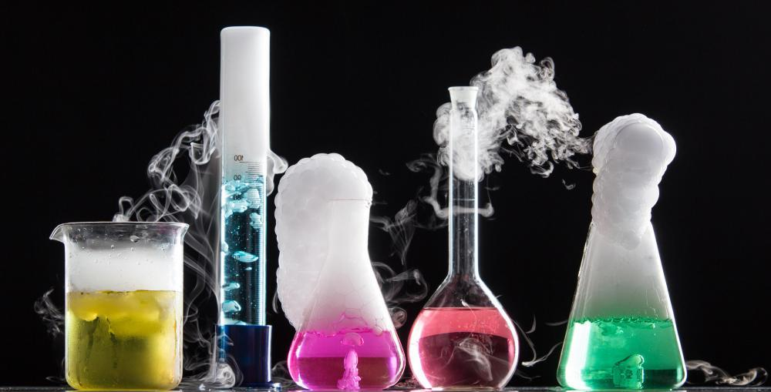
What is chemistry?
?
Notes:
NOTES: In primary school, you learnt science. However, in secondary school, it has three different subjects, that is Chemistry, Biology and Physics. Did you know that chemistry is all around us? Most of you used a product from chemistry like Vaseline. Aren’t we lucky that we are going to learn Chemistry? In this topic, you will learn what chemistry is and it involves. You will also know the role of chemistry in our daily lives and to Uganda.

Slide 4

Activity 1.1
Finding substances in our everyday lives that relate to chemistry
In groups, discuss which common things in everyday life are made of chemicals?
Look up the meaning of the word Chemistry in the Dictionary. Discuss the meaning of the word with friends.
Present your findings to the whole class
Notes:
The key question is What is the meaning of Chemistry?
Note: Students should work in groups.

Slide 5

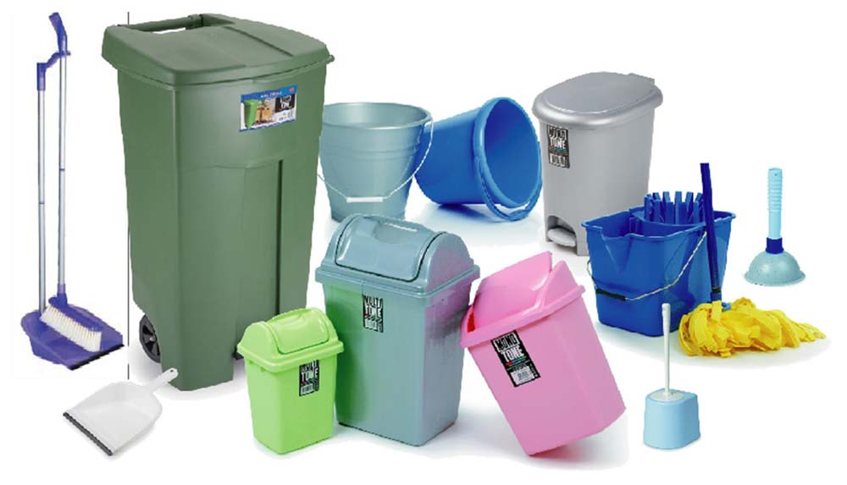
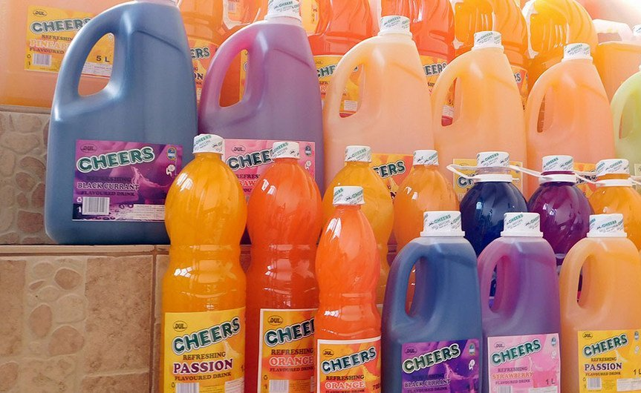
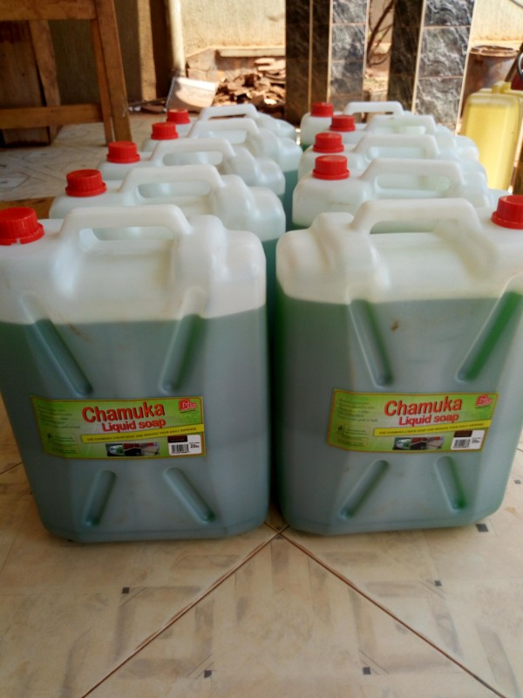
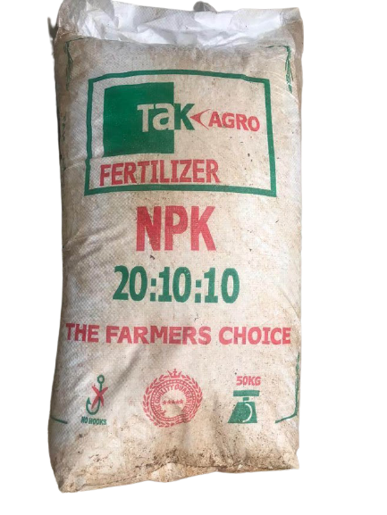
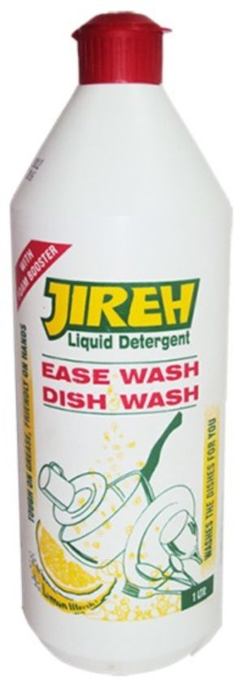
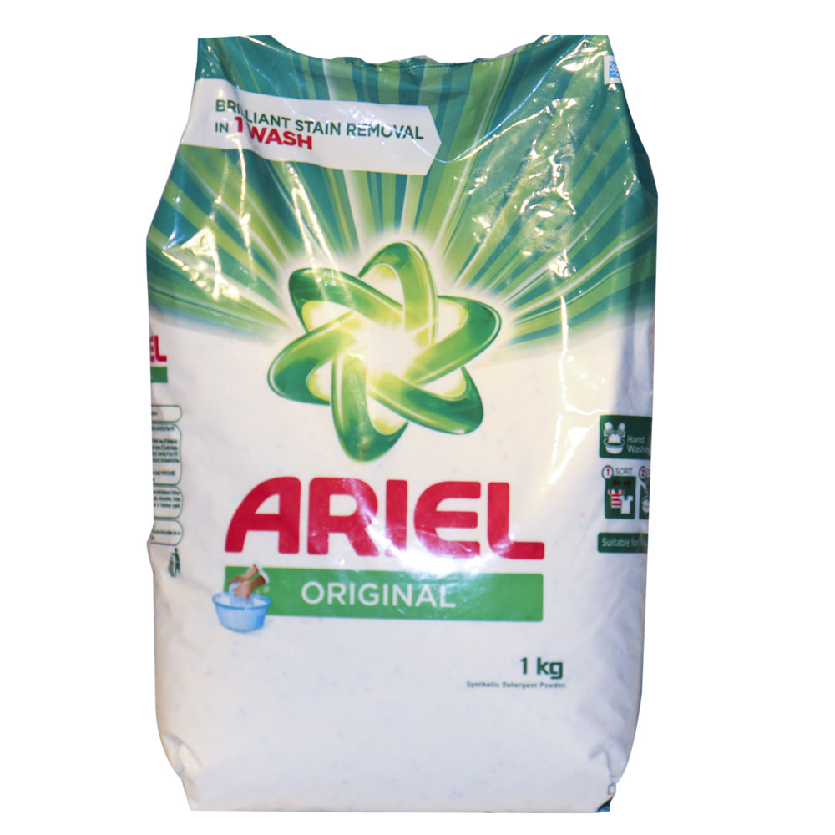
Products made with the knowledge of Chemistry in Uganda
Notes:
Explore these products with these questions – also found on the following slide:
What are the uses of the items in the pictures?
Name other products that are made using the knowledge of chemistry. E.g. Other types of soaps.
What careers do you think require the study and knowledge of chemistry?

Slide 6
Activity 1.2
Uses of Chemistry in our Everyday Life
What are the uses of the items in the pictures?
Discuss other products that are made using the knowledge of chemistry. Explore the following places:
  Kitchen
  Washroom
  Supermarket
  Hospital/Pharmacy
  Sitting room
What careers do you think require the study and knowledge of chemistry?
Name of Place | Items made using the knowledge of chemistry
Kitchen | Water, Salt
Washroom | Soap, …
Supermarket
Hospital/Pharmacy
Sitting room

Slide 7

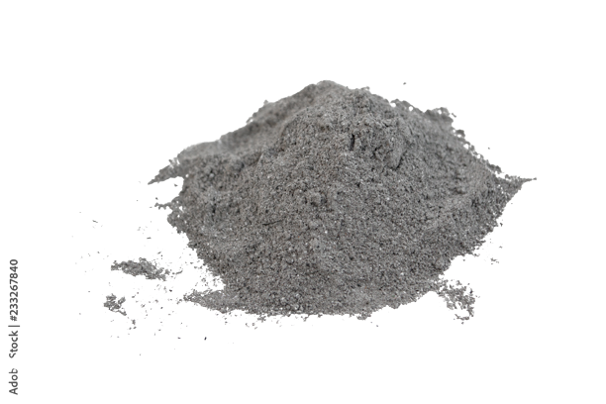
Activity 1.3
The meaning of Chemistry. Changes that take place to substances everyday
Burn a piece of paper using a candle or a lighted match stick. What changes take place to the paper during the burning?
2. Now consider the following processes which take place in everyday life:
  The rusting of a kitchen knife
  The boiling of water
  The rotting of fruits
  Describe the changes that take place in each of the processes (i – iii) above.
  What are the necessary conditions for each of the above changes to take place?
Name any other processes in which materials change from one form to another? The changes you have observed and many others show what the study of chemistry is about.
What you need:
Paper, Match-Stick, An open space

Slide 8

Did you discover that…
Chemistry is all around us the things we use
Common chemicals in pharmaceuticals and cosmetics, plastics, food and beverages, soaps and detergents, water treatment, and local chemistry in your local environments are related to chemistry.
Chemistry is a branch of science
From the burning paper, Chemistry is defined as the study of structure, composition, and properties of matter and the changes that occur on matter
Matter refers to substances that we can see, touch, breath or feel around us
Most of the materials and chemicals we use at home and other places are made using the knowledge of chemistry.

Slide 9
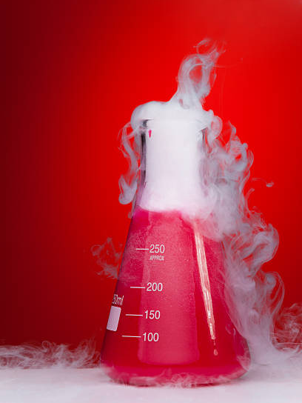
Activity 1.4
Reasons why we should study chemistry
Through consulting the internet, textbooks or resourceful adults, find out and discuss the sectors of the economy where the knowledge of chemistry is applied
Now search for the application of chemistry in the following sectors:
  Technology
  Water sector
  Health sector
  Agriculture
  Food industry
  The environment
  Transport sector
  Manufacturing industry
Notes:
NOTES: We have already seen that the knowledge of chemistry is applied in many sectors like agriculture, health, education, beauty etc. To learn more about why we should study chemistry, let students do Activity 1.4.

Slide 10


Chemistry knowledge in Technology
Phone Batteries
Car Batteries

Slide 11
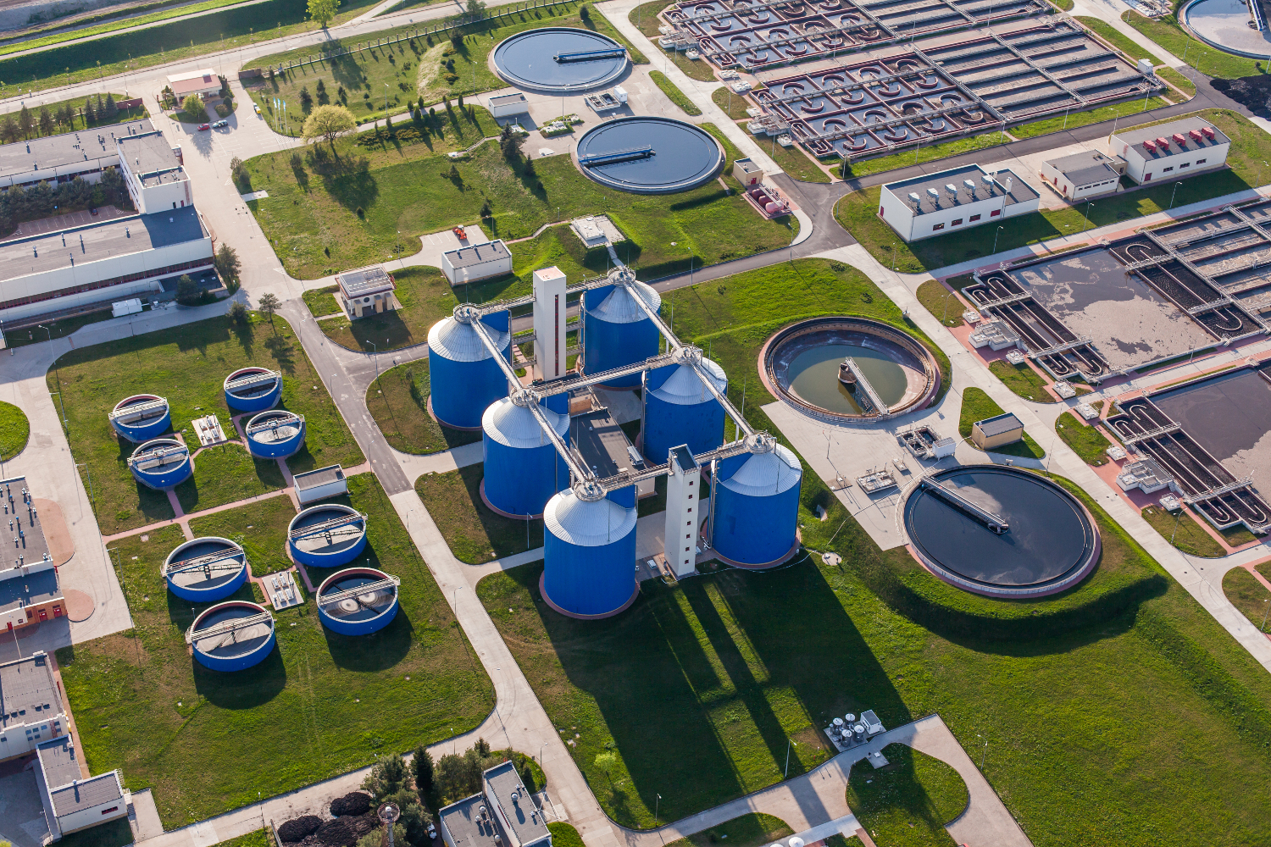
Chemistry in the Water Sector
For water treatment
Also check out this video: https://www.youtube.com/watch?v=s8IVjQg7yno

Slide 12




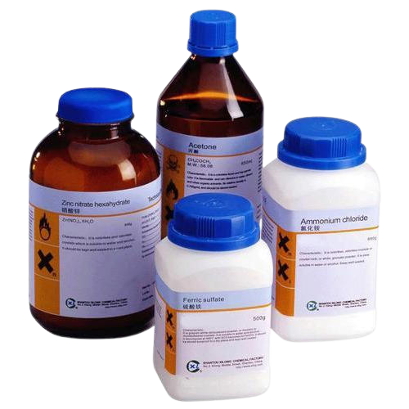
Chemistry in the health Sector
Making Drugs
Diagnosing diseases
Sanitizers
Gloves
Reagents

Slide 13
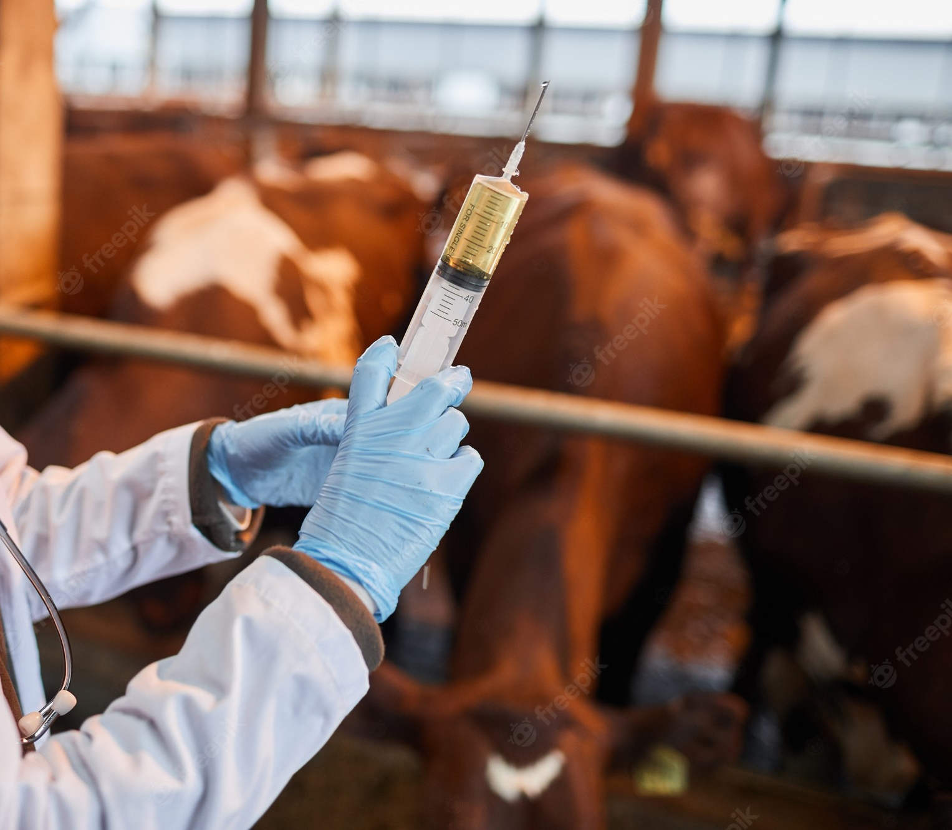
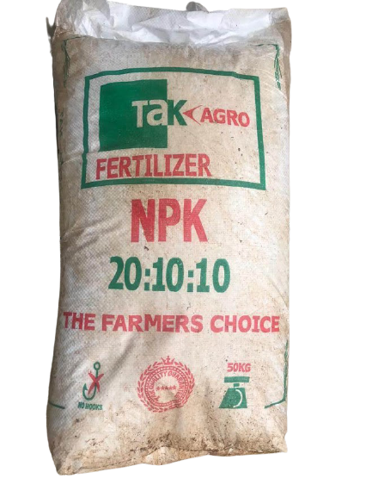
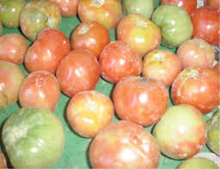
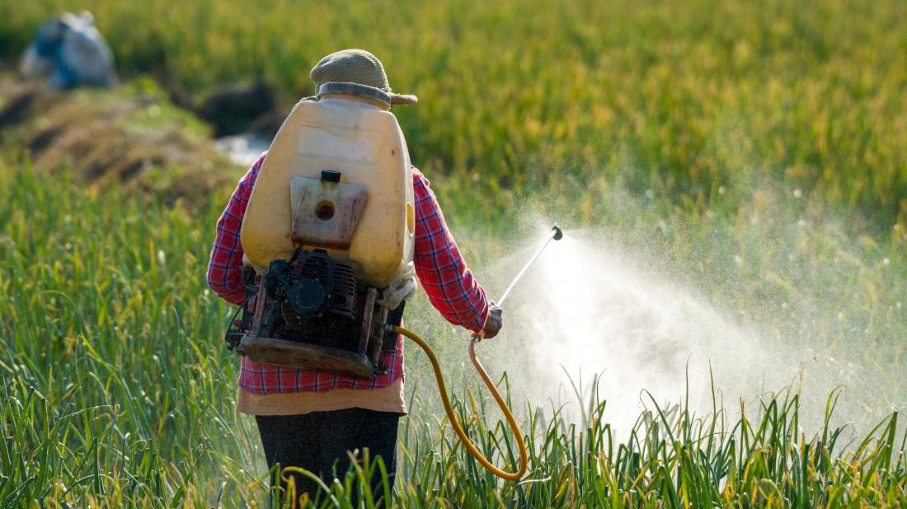
Chemistry in the Agricultural Sector
Pesticides
Herbicides
Drugs for animals
Fertilizer
Notes:
Herbicides are sprayed to kill weeds

Slide 14
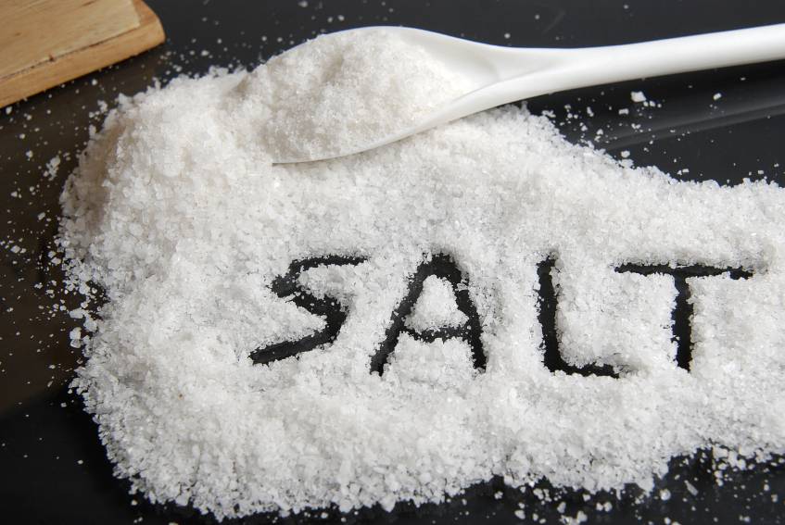

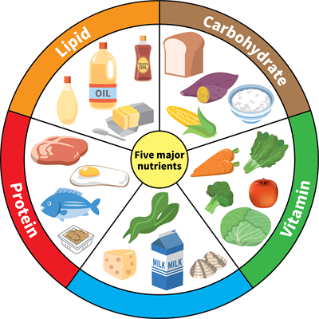
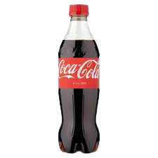
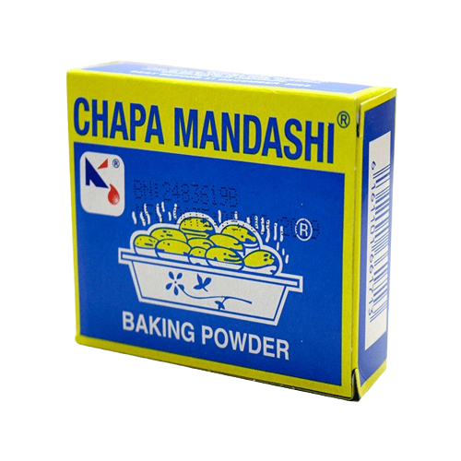
Chemistry in the Food Industry
Notes:
Also, the knowledge of chemistry is used to:
Check the safety of food for human consumption
Make food preservatives to make food last longer

Slide 15
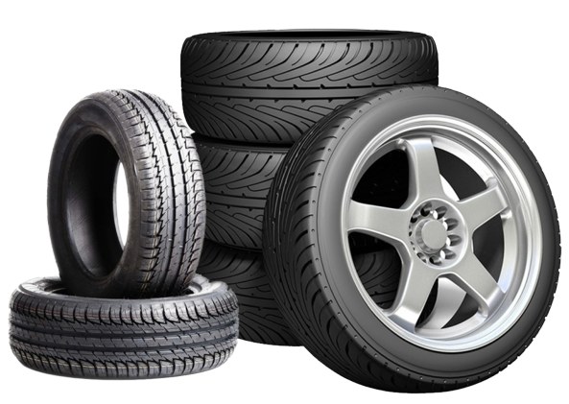


Chemistry in the transport sector

Slide 16
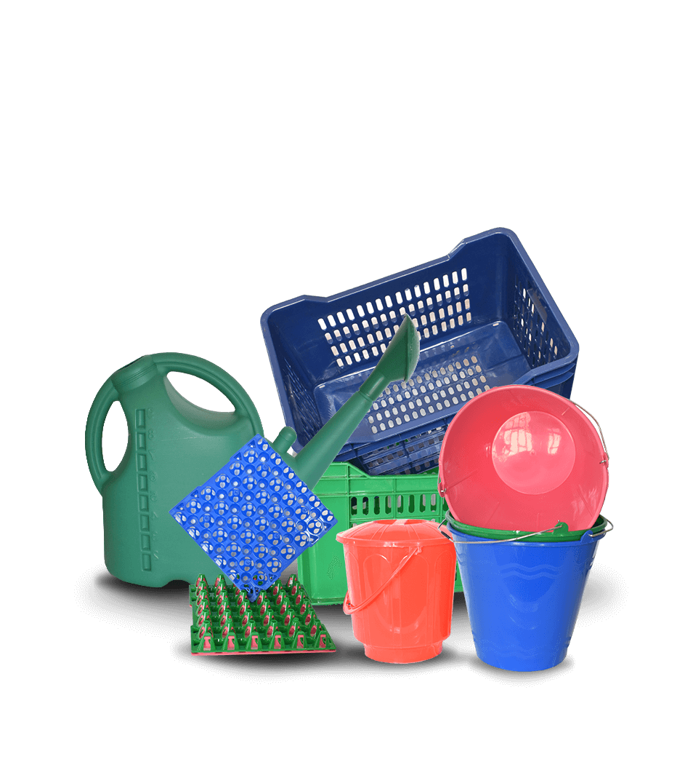
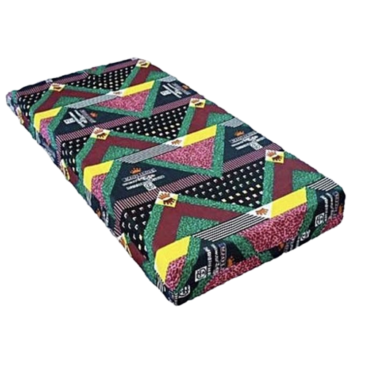

Chemistry in the manufacturing industry

Slide 17

Summary
Summarize the reasons why we should study chemistry

Slide 18
Activity 1.5
Relationship between Chemistry and other subjects
Research how chemistry is related to the following:
Biology
Chemistry
Physics
Geology
Mathematics
Chemistry
Physics
Biology
Geology
Mathematics
What is needed for the activity:
Internet, Textbooks or Consulting Adults
Notes:
Biology – Biochemistry – branch of science that explores chemical processes behind living organisms
Physics – Physical Chemistry – Study of the occurrence of the phenomena that links chemistry and physics
Geology – Geochemistry – Science uses principles of chemistry to explain mechanisms behind major geological systems like earth’s crust and oceans
Mathematics - Calculations

Slide 19
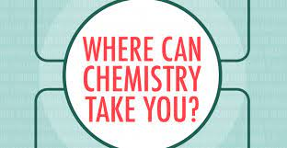
Activity 1.6
What careers can a person that studies chemistry pursue?
Review with your group members the applications of chemistry to different sectors in Uganda
Find out and discuss careers that people who work in the following sectors pursue:
  Education
  Health
  Agriculture
  Manufacturing
  Construction
Present your findings to the rest of the class
Notes:
NOTES:
Medical doctor – diagnoses diseases and prescribes medicine
Pharmacist – Drug specialist who advises on proper drug use
Pharmacologist – Develops and tests drugs in the laboratory
Chemistry teacher – Teaches chemistry
Analytical chemist – Analyses the quality of food and drugs for safety for human consumption
Forensic scientist – Collects evidence at crime scenes like blood and hair for analysis to be used in legal investigations and rule of law

Slide 20

Test Your Knowledge
State one way each of the following subjects is related to chemistry:
    Biology
    Physics
    Geology
Identify four careers and professions that apply the knowledge and skills acquired in chemistry
State three sectors in the Ugandan economy that rely on the knowledge of chemistry

Slide 21
Activity 1.7 (a)
What is the contribution of chemistry to the economy of Uganda?
In groups, research on how Chemistry contributes to the economy of Uganda.
Base your research in the fields of medicines, industries, transport and agriculture.
Write a short report identifying the areas in chemistry which contribute to the economy of Uganda.

Slide 22
Activity 1.7 (b)
What is the contribution of chemistry to the economy of Uganda?
Visit an industry, company, organization or interview a person who works in these organizations where the knowledge of chemistry is applied.
Find out the following:
  How is the knowledge of chemistry applied in the organization?
  How does the firm benefit:
      The employees
      People living near the firm
      The government
      The surrounding environment
Translate what you have discovered into ways in which chemistry contributes to the Ugandan economy
Write a report on the importance of chemistry to the Ugandan economy.
Present the report to the whole class
What you need:
Support from the teacher, Permission to visit organizations or talk with an adult

Slide 23
Chemistry and the economy of Uganda
Mukwano group of companies makes soap, cooking oil, detergents, bottled water that has created employment for a lot of Ugandans. Ugandans are more healthy which enables them to work and contribute to Uganda’s economy
Joint Clinical Research located at Makerere University and Uganda Virus Research Institute have helped in making strides in the fight against diseases like HIV/AIDS, Malaria and Tuberclosis
The government of Uganda collects taxes from companies that use chemistry knowledge and it uses those taxes to construct roads, stock hospitals with medicines, pay doctors, teachers and other government workers, and develop the country
Skills from teachers, doctors, nurses and other professionals use their experience to improve the lives of Ugandans. They also pay taxes.

Slide 24
TOPIC: Chemistry and Society
Chemistry is a laboratory science. Its subject materials and theories are based on experimental observation.
Common chemicals in pharmaceutics and cosmetics, plastics, food and beverages, soaps and detergents, water treatment, and chemistry in your local environments are related to chemistry.
Chemistry is the study of matter and the changes that occur to substances under different conditions.
The importance of chemistry in everyday life and the careers linked to the study of chemistry include teachers, doctors, pharmacists among others.
Chemistry plays a vital role in feeding the growing world population and contributes greatly to the Ugandan economy.

Slide 25

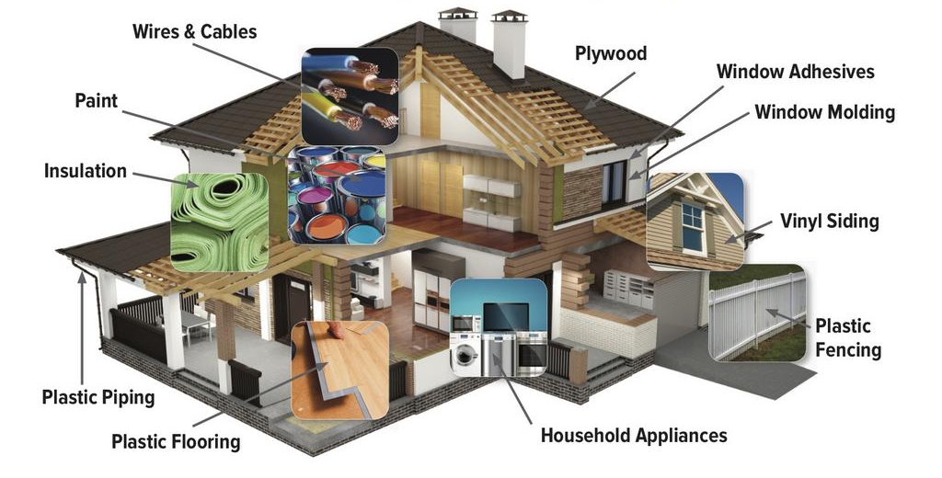


Activity of Integration (a)
As a young Chemistry student, organise a half-day workshop for people in your community to sensitise them on the application of Chemistry in their everyday life, and the economic contribution of Chemistry to the country. Your sensitisation message should clearly bring out the application of Chemistry in everyday life, contribution of Chemistry to the economy of the society and ensure that members of the community appreciate the use of Chemistry in everyday life. Use the figures below.
Common things we eat and drink
Materials used on a house

Slide 26
Activity of Integration (b)
You are now aware of what chemistry is, its importance, careers and professions related to it. Draw a mind map that summarizes the branches of science, careers related to knowledge of chemistry and other subjects required in each other than Chemistry.

